Slide 1
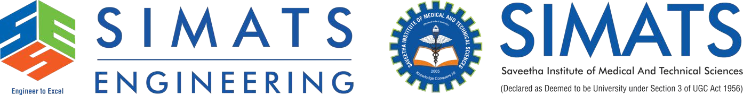
Comparison Between File-Based Systems and DBMS Using Real-Life Case Studies from Banking and Healthcare
Presented by:
Antony Magrin J(192572103)
CSA0506 DATABASE MANAGEMENT SYSTEM
Date: 21/07/2026
Technical Presentation

Slide 2
Introduction
What is a File-Based System?
A file-based system stores data in separate files.
Each department maintains its own files independently.
Data sharing between departments is difficult.
File System: Student details stored in Excel files.
What is a DBMS?
A Database Management System (DBMS) is software that stores, organizes, and manages data efficiently.
It allows multiple users to access the same data securely.
DBMS: Student information stored in a centralized college database.

Slide 3
FILE BASED SYSTEM VS DBMS
File Based System | DBMS
Data stored in separate files | Data stored in a centralized database
High data redundancy | Minimal Redudndancy
Difficult to share data | Easy Data Sharing
Limited security | Strong Securit and Access Control
Backup is manual | Automatic Bacup and recovery
Difficult maintenance | Easy maintentce and update
Slower data retrieval | Faster Query Process

Slide 4
Banking Case study
Scenario: Customer Account Management
File-Based System
Customer information stored in separate branch files.
Updating account details in one branch does not update other branches.
Duplicate customer records may exist.
Transactions take longer due to manual verification.
DBMS
All branches access one centralized database.
Customer information is updated instantly.
Real-time balance updates.
Secure online banking and ATM services
Result
Faster banking operations
Accurate customer records
Improved security
Better customer service

Slide 5
Healthcare Case Study
Scenario: Hospital Patient Records
File-Based System
Patient records stored on paper or separate computer files.
Doctors cannot easily access previous medical history.
Reports may be duplicated or misplaced.
Higher chance of errors.
DBMS
Electronic Health Records (EHR) stored in one database.
Doctors can instantly access patient history.
Lab reports and prescriptions are updated automatically.
Secure access for authorized medical staff.
Result
Faster diagnosis
Better patient care
Reduced paperwork
Improved data accuracy

Slide 6
Conclusion
Key Takeaways
File-based systems are suitable only for small applications.
DBMS eliminates data redundancy and inconsistency.
DBMS provides better security, backup, and recovery.
Banking and healthcare rely on DBMS for efficient and reliable data management.
Modern organizations prefer DBMS because it supports centralized, secure, and real-time data access.
"A DBMS transforms scattered data into organized, secure, and meaningful information, enabling smarter decisions and efficient operations."

Slide 7

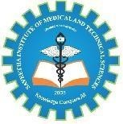
Thank You!!!

